Slide 1

Benchmarking Streaming ASR for Real-time Deployment:
A Robustness Scorecard and Error Taxonomy for Vietnamese
Quoc Hung Nguyen, Hoai An Thai, Duy Tan Nguyen, Vy Le, Thi Thuy Duong Nguyen
UEH College of Technology and Design — University of Economics Ho Chi Minh City
Corresponding author: hungngq@ueh.edu.vn
ICCCNet-2026 · Manchester, UK · 17 July 2026
Notes:
[0:00–0:15]
Good [morning/afternoon]. I'm [NAME], from the University of Economics Ho Chi Minh City. Our question is simple: when we pick a Vietnamese ASR model by offline word error rate, does that choice survive real streaming deployment? We built a reproducible benchmark that measures accuracy, latency, cost and robustness together — and the answer is often no.

Slide 2
1. INDEX
Outline
Motivation — why offline WER misleads streaming deployment
Related work & the gap for Vietnamese streaming ASR
Evaluation pipeline: chunking, latency profiles, metrics
Results: offline vs. streaming WER, latency–accuracy frontier
Robustness & stability under distribution shift
Comparative analysis: accuracy vs. runtime trade-off
Conclusion, error taxonomy & future work
Notes:
[0:15–0:30]
Briefly, the plan: motivation, how we differ from existing benchmarks, our evaluation pipeline, then the results — offline versus streaming WER, the latency–accuracy frontier, and robustness. I'll close with the accuracy-versus-speed trade-off and future work.

Slide 3
2. ABSTRACT
Offline WER alone is insufficient for streaming model selection
Vietnamese ASR is increasingly deployed in production — under latency budgets and limited compute, not offline conditions.
A reproducible streaming evaluation framework: standardized chunking, right-context (look-ahead), overlap handling & metrics.
Reports WER and real-time factor (RTF) under three latency profiles: 1200 / 2400 / 4000 ms.
Evaluated on 4 public datasets — VIVOS, VLSP2020, Viet YouTube ASR v2, Speech-MASSIVE_vie — as a robustness scorecard.
Adds a preliminary Vietnamese error taxonomy: numerals, punctuation, named entities & Vietnamese–English code-switching.
➜ One framework that reports accuracy, latency & robustness together — the numbers a deployment decision needs.
Notes:
[0:30–1:10]
In one slide: Vietnamese ASR is going into production, where systems must meet latency budgets on limited hardware — yet models are still chosen on offline WER. We built a streaming evaluation framework that standardizes the parts that usually differ across papers — chunk size, look-ahead, overlap — and reports WER and real-time factor under three realistic latency profiles, on four public Vietnamese datasets from clean read speech to in-the-wild audio. We also add a preliminary Vietnamese-specific error taxonomy. The takeaway is the callout: one framework reporting accuracy, latency and robustness together.

Slide 4
3. INTRODUCTION
Model selection by offline WER is misaligned with real-time deployment
The problem
  Production ASR runs incrementally under latency budgets & limited compute — offline full-context decoding does not.
  Streaming WER depends on chunk size, look-ahead & overlap; described inconsistently → papers hard to compare.
Sharper for Vietnamese
  Benchmarks favor clean read speech, but real usage is spontaneous, in-the-wild and accent-variable.
  Numerals, punctuation, named entities & Vietnamese–English code-switching add errors aggregate WER can hide.
➜ We need a system-oriented benchmark that measures models the way they are actually deployed.
Notes:
[1:10–2:05]
Let me make the problem concrete. In deployment, an ASR system runs incrementally, under a latency budget, on constrained hardware — offline WER measures none of that. Worse, the streaming WER papers do report depends heavily on decoding settings like chunk size and look-ahead, described inconsistently, so cross-paper comparison is unreliable.
For Vietnamese it's sharper: benchmarks lean on clean read speech, but real traffic is spontaneous, in-the-wild and accent-variable. And Vietnamese transcripts are sensitive to numerals, punctuation, named entities and code-switching — errors aggregate WER can mask. So we need to measure models the way they're deployed.

Slide 5
4. LITERATURE REVIEW
No prior work jointly reports WER, RTF & streaming degradation for Vietnamese
Work | Lang. | Streaming | Latency / RTF | Robustness | Error analysis | Repro.
WeNet toolkit [20] | Multi | Yes | Yes | No | No | Yes
Open ASR Leaderboard [19] | Multi | No | Yes | No | No | Yes
Vietnamese ASR benchmarks [1,15] | Vi | No | No | Partial | No | Partial
This work | Vi | Yes | Yes | Yes | Yes | Yes
Table 1 — Related ASR benchmarks (green = supported, red = not).
Four gaps we close: G1 streaming settings not standardized · G2 latency & cost reported in isolation · G3 robustness not tied to streaming · G4 no Vietnamese error breakdown
➜ First Vietnamese benchmark to unify streaming, latency/RTF, robustness, error analysis & reproducibility.
Notes:
[2:05–2:45]
Existing streaming toolkits like WeNet, or leaderboards like Open ASR, standardize some reporting — but none jointly cover streaming, latency/RTF, robustness under shift and error analysis. Existing Vietnamese benchmarks are mostly offline on clean speech. The bottom row is us — the first Vietnamese benchmark to unify all of these. Concretely we close four gaps: unstandardized streaming settings; latency and cost reported in isolation; robustness not tied to streaming; and no Vietnamese error breakdown.

Slide 6
5. RESEARCH GAPS
Four gaps motivate a system-oriented streaming benchmark
G1 Streaming settings not standardized
Chunk size, look-ahead and overlap vary across papers, so reported streaming WER is not comparable.
G2 Latency & cost reported in isolation
WER, ΔWER (streaming − offline) and RTF are rarely reported together under the same latency profiles.
G3 Robustness not tied to streaming
Distribution-shift robustness is studied offline; streaming can amplify degradation but it goes unmeasured.
G4 No Vietnamese error breakdown
Numerals, punctuation, named entities and code-switching are not analyzed for Vietnamese streaming ASR.
➜ Our contribution: a reproducible protocol + robustness scorecard + preliminary error taxonomy that close G1–G4.
Notes:
[2:45–3:20]
We frame the contribution around four gaps. G1: streaming settings aren't standardized, so streaming WER isn't comparable. G2: accuracy, streaming degradation and runtime cost are rarely reported together under matched latency. G3: robustness to shift is usually studied offline, even though streaming amplifies it. G4: for Vietnamese there's no error breakdown for the categories that matter. Our protocol, robustness scorecard and error taxonomy address all four.

Slide 7
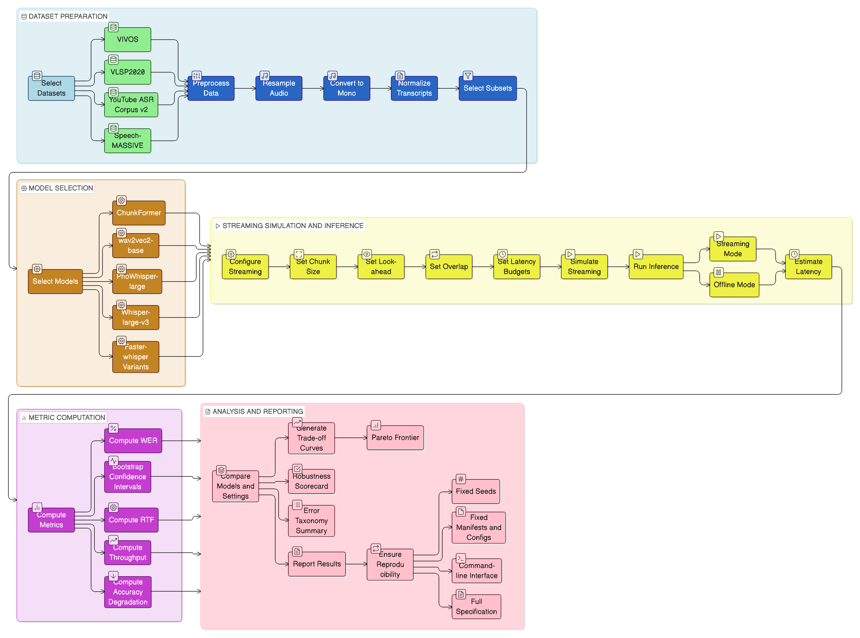
6. PROPOSED METHODOLOGY
A reproducible pipeline: fixed-size chunking, three latency budgets, one command
Profile | Chunk | Overlap | Look-ahead
Low latency | 1200 ms | 200 ms | 0 ms
Balanced | 2400 ms | 200 ms | 0 ms
High context | 4000 ms | 200 ms | 0 ms
  Data: VIVOS (clean) · VLSP2020 (spontaneous) · Viet YouTube v2 (in-the-wild) · Speech-MASSIVE_vie (assistant) — 300-utt subsets, unified normalization.
  Streaming models: ChunkFormer-CTC-large (110M) · wav2vec2-base-vi (95M) — swept over all 3 profiles.
  Offline baselines: PhoWhisper-large & Whisper-large-v3 (1.55B).
  Metrics: strict WER + 95% bootstrap CI · RTF & throughput (1× H100) · streaming stability. Inference-only — no retraining.
Fig. 1 — Evaluation pipeline (4 stages).
Notes:
[3:20–4:15]
The pipeline has four inference-only stages, reproducible from one command: prepare data with unified normalization; simulate streaming by fixed-size chunking with bounded right context; compute metrics; export tables and figures.
Three latency profiles — 1200, 2400, 4000 ms of chunk, all with 200 ms overlap and zero look-ahead, so the latency proxy is just the chunk size. Four datasets from clean read speech to in-the-wild, on fixed 300-utterance subsets. Two streaming models swept across profiles, plus two large offline models as reference. Main metric strict WER with bootstrap CIs, plus RTF on a single H100. Nothing is retrained — we isolate the effect of streaming constraints alone.

Slide 8
7. RESULTS & DISCUSSION
Streaming inflates WER far beyond the offline gap — worst on spontaneous speech
Model | Dataset | Offline | Streaming | ΔWER
ChunkFormer-CTC (110M) | VIVOS | 3.44 | 6.17 | +2.74
 | VLSP2020 | 3.83 | 50.64 | +46.81
 | Viet YouTube v2 | 4.48 | 5.44 | +0.96
 | Speech-MASSIVE | 18.78 | 21.38 | +2.60
wav2vec2-base-vi (95M) | VIVOS | 8.88 | 12.32 | +3.44
 | VLSP2020 | 10.09 | 52.74 | +42.65
 | Viet YouTube v2 | 7.90 | 8.31 | +0.40
 | Speech-MASSIVE | 27.71 | 30.38 | +2.68
Offline gap is small everywhere — streaming reveals it.
  VLSP2020 (spontaneous) collapses to ~50% streaming: +40–47 pp.
  Clean (VIVOS) & in-the-wild (YouTube) stay well-behaved.
  Robustness scorecard @ 4000 ms: VLSP2020 shift +44 pp / +720% vs clean VIVOS.
Offline ranking ≠ streaming ranking.
Table 2 — WER (%). Offline PhoWhisper / Whisper baselines in paper.
➜ Two models with near-identical offline WER diverge by tens of points once streamed.
Notes:
[4:15–5:35]
The core result. Offline versus streaming WER for both streaming models on all four datasets. The offline column is uniformly reasonable — on VLSP2020 both are under 11% offline. Now the streaming column: on VLSP2020 both collapse to about 50% — a jump of 40 to 47 percentage points. That's the argument in one table. On clean read speech and even in-the-wild YouTube, streaming stays well-behaved; the damage concentrates on spontaneous speech. Our robustness scorecard makes this explicit: at 4000 ms the VLSP2020 shift is +44 percentage points — over +700% relative to clean VIVOS. And a paired bootstrap test finds 7 of 8 streaming runs significantly degraded.
The consequence: the offline ranking doesn't predict the streaming ranking. Two models with almost identical offline WER diverge by tens of points once streamed — so offline WER alone cannot choose your deployment model.

Slide 9
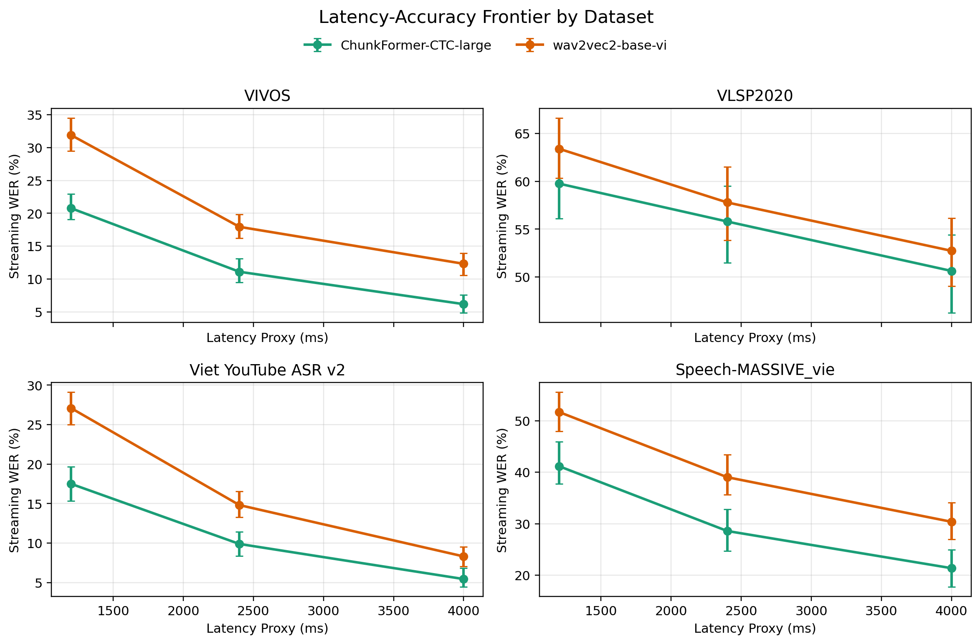
8. COMPARATIVE ANALYSIS
Latency helps every model — but ChunkFormer leads accuracy, wav2vec2 leads speed
Model | RTF | Throughput | Mode
ChunkFormer-CTC (110M) | 0.0111 | 90.1× | Yes
wav2vec2-base-vi (95M) | 0.0059 | 169.5× | Yes
PhoWhisper-large (1.55B) | 0.1034 | 9.7× | Offline
Whisper-large-v3 (1.55B) | 0.0903 | 11.1× | Offline
Table 3 — RTF & throughput on 1× H100 80GB (lower RTF / higher throughput = faster).
  Bigger chunks cut streaming WER: mean 35%→21% (ChunkFormer), 44%→26% (wav2vec2).
  ChunkFormer wins accuracy everywhere; wav2vec2 ~1.9× faster; big offline models ~10–17× costlier.
  VLSP2020 stays >50% even at 4000 ms → instability, not just latency.
Fig. 2 — Streaming WER (95% CI) across 1200 / 2400 / 4000 ms.
➜ No model wins both — deployment is a point on the WER × RTF × latency frontier.
Notes:
[5:35–6:55]
Now accuracy, latency and cost together. On the left, the latency–accuracy frontier: as chunk size grows from 1200 to 4000 ms, streaming WER falls monotonically — ChunkFormer's mean from about 35% to 21%, wav2vec2 from 44% to 26%. More right context, fewer revisions. But VLSP2020, top-right, stays above 50% even at the largest chunk — an instability problem, not just latency; no chunk size we tested rescues it.
On the right, runtime: ChunkFormer beats wav2vec2 on accuracy everywhere, but wav2vec2 is roughly 1.9 times faster — 169 versus 90 times real-time. The two large offline models have the best offline WER but are 10 to 17 times costlier and a poor streaming fit. No single number captures this: the deployment decision is a point on a frontier of streaming WER, RTF and latency — the surface our benchmark reports.

Slide 10
9. CONCLUSION & FUTURE WORK
A deployment-aligned benchmark changes which Vietnamese ASR model you ship
Conclusions
  Offline-WER-only selection can mislead — streaming constraints & runtime cost reorder model families.
  Matched-latency WER / ΔWER / RTF comparison exposes favorable accuracy–efficiency configurations.
  Robustness scorecard: streaming amplifies degradation on spontaneous & in-the-wild Vietnamese speech.
Future work
  Quantify the error taxonomy: numerals, abbreviations, named entities, Vietnamese–English code-switching.
  More streaming architectures & low-resource adaptation; explicit latency-budget sweeps; finer end-to-end latency.
  Grow into an open, continuously updated Vietnamese streaming ASR evaluation platform.
➜ Open & reproducible: github.com/hoaianthai345/ASR_Vietnamese_Benchmark · hungngq@ueh.edu.vn
Notes:
[6:55–7:45]
To conclude: choosing a Vietnamese ASR model on offline WER alone can mislead, because streaming constraints and cost reorder the model families. Comparing WER, streaming degradation and RTF under matched latency surfaces the well-balanced configurations, and our robustness scorecard shows streaming amplifies degradation exactly where Vietnamese production traffic lives — spontaneous and in-the-wild speech.
Future work: quantify the error taxonomy, add streaming architectures and low-resource adaptation, and grow this into an open, continuously updated platform. Everything is public at the repository shown; this work is funded by UEH. Thank you — happy to take questions.

Slide 11
10. REFERENCES
References (selected)
[1] AILAB, VNUHCM-US. VIVOS: Vietnamese speech corpus for ASR. Zenodo (2016).
[2] Barker, J. et al. The third CHiME speech separation and recognition challenge. Comput. Speech Lang. 46 (2017).
[3] Benzeghiba, M. et al. ASR and speech variability: a review. Speech Communication 49 (2007).
[4] Bisani, M., Ney, H. Bootstrap estimates for confidence intervals in ASR evaluation. ICASSP (2004).
[5] Dinh, N.V. et al. Multi-dialect Vietnamese: task, dataset, baseline models and challenges. EMNLP (2024).
[9] Speech-MASSIVE: multilingual assistant-style speech dataset (Vietnamese subset).
[11] Viet YouTube ASR v2: in-the-wild Vietnamese speech corpus.
[15] VLSP2020 Vietnamese ASR shared task dataset.
[19] Open ASR Leaderboard. [20] WeNet: streaming end-to-end speech recognition toolkit.
[22] Streaming ASR models — latency/RTF under controlled configurations.
Full list (23 entries) in the paper. Repository: github.com/hoaianthai345/ASR_Vietnamese_Benchmark
Notes:
[Backup during Q&A] Selected references; full 23-entry list in the paper.

